Slide 1
Philippians 1
To the glory of Christ

Slide 2
Philippians 1
Greeting
1 Paul and Timothy, servants[a] of Christ Jesus,
To all the saints in Christ Jesus who are at Philippi, with the overseers[b] and deacons:[c]
2 Grace to you and peace from God our Father and the Lord Jesus Christ.
Thanksgiving and Prayer
3 I thank my God in all my remembrance of you, 4 always in every prayer of mine for you all making my prayer with joy, 5 because of your partnership in the gospel from the first day until now

Slide 3
6 And I am sure of this, that he who began a good work in you will bring it to completion at the day of Jesus Christ. 7 It is right for me to feel this way about you all, because I hold you in my heart, for you are all partakers with me of grace,[d] both in my imprisonment and in the defence and confirmation of the gospel. 8 For God is my witness, how I yearn for you all with the affection of Christ Jesus. 9 And it is my prayer that your love may abound more and more, with knowledge and all discernment, 10 so that you may approve what is excellent, and so be pure and blameless for the day of Christ, 11 filled with the fruit of righteousness that comes through Jesus Christ, to the glory and praise of God.

Slide 4
The Advance of the Gospel
12 I want you to know, brothers,[e] that what has happened to me has really served to advance the gospel, 13 so that it has become known throughout the whole imperial guard[f] and to all the rest that my imprisonment is for Christ. 14 And most of the brothers, having become confident in the Lord by my imprisonment, are much more bold to speak the word[g] without fear.

Slide 5
¹⁵ Some indeed preach Christ from envy and rivalry, but others from good will. ¹⁶ The latter do it out of love, knowing that I am put here for the defence of the gospel. ¹⁷ The former proclaim Christ out of rivalry, not sincerely but thinking to afflict me in my imprisonment. ¹⁸ What then? Only that in every way, whether in pretence or in truth, Christ is proclaimed, and in that I rejoice.

Slide 6
To Live Is Christ
Yes, and I will rejoice, ¹⁹ for I know that through your prayers and the help of the Spirit of Jesus Christ this will turn out for my deliverance, ²⁰ as it is my eager expectation and hope that I will not be at all ashamed, but that with full courage now as always Christ will be honoured in my body, whether by life or by death. ²¹ For to me to live is Christ, and to die is gain. ²² If I am to live in the flesh, that means fruitful labour for me. Yet which I shall choose I cannot tell. ²³ I am hard pressed between the two. My desire is to depart and be with Christ, for that is far better. ²⁴ But to remain in the flesh is more necessary on your account. ²⁵ Convinced of this, I know that I will remain and continue with you all, for your progress and joy in the faith, ²⁶ so that in me you may have ample cause to glory in Christ Jesus, because of my coming to you again.

Slide 7
27 Only let your manner of life be worthy[h] of the gospel of Christ, so that whether I come and see you or am absent, I may hear of you that you are standing firm in one spirit, with one mind striving side by side for the faith of the gospel, 28 and not frightened in anything by your opponents. This is a clear sign to them of their destruction, but of your salvation, and that from God. 29 For it has been granted to you that for the sake of Christ you should not only believe in him but also suffer for his sake, 30 engaged in the same conflict that you saw I had and now hear that I still have.

Slide 8
Philippians 1
To Who, From Where?
How did he end up there?
What did he write?

Slide 9
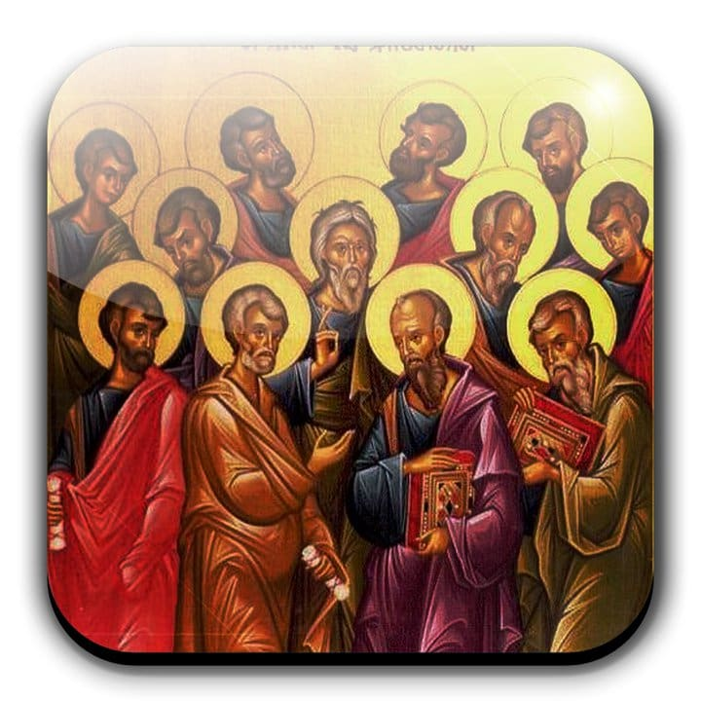
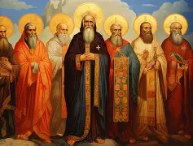
What is a saint?

Slide 10
We are saints, if we are believers
Paul wrote from prison in Rome

Slide 11
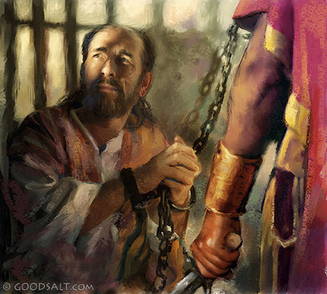

Slide 12
Acts 15 v 36 - 41
36 And after some days Paul said to Barnabas, “Let us return and visit the brothers in every city where we proclaimed the word of the Lord, and see how they are.” 37 Now Barnabas wanted to take with them John called Mark. 38 But Paul thought best not to take with them one who had withdrawn from them in Pamphylia and had not gone with them to the work. 39 And there arose a sharp disagreement, so that they separated from each other. Barnabas took Mark with him and sailed away to Cyprus, 40 but Paul chose Silas and departed, having been commended by the brothers to the grace of the Lord. 41 And he went through Syria and Cilicia, strengthening the churches.

Slide 13
Acts 16 v 6 - 10
6 And they went through the region of Phrygia and Galatia, having been forbidden by the Holy Spirit to speak the word in Asia. 7 And when they had come up to Mysia, they attempted to go into Bithynia, but the Spirit of Jesus did not allow them. 8 So, passing by Mysia, they went down to Troas. 9 And a vision appeared to Paul in the night: a man of Macedonia was standing there, urging him and saying, “Come over to Macedonia and help us.” 10 And when Paul[c] had seen the vision, immediately we sought to go on into Macedonia, concluding that God had called us to preach the gospel to them.

Slide 14
How did he end up in Philippi?
Forbidden to speak the word in Asia
Also stopped from going to Bithynia
Vision to go to Macedonia (Europe)

Slide 15
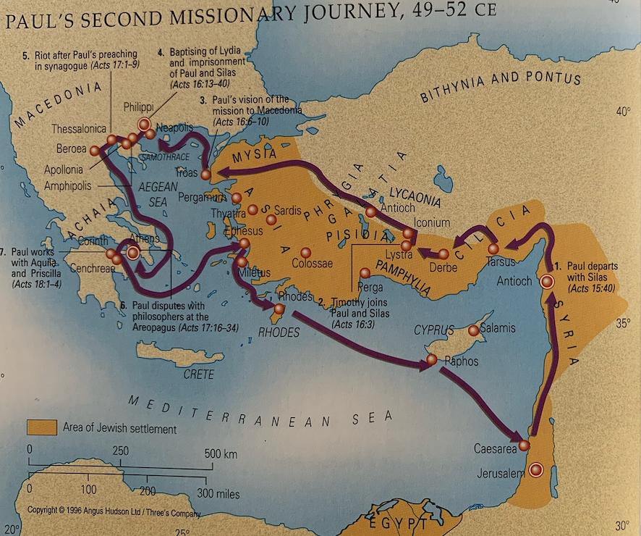

Slide 16
Matthew 28 v 18
18 And Jesus came and said to them, “All authority in heaven and on earth has been given to me. 19 Go therefore and make disciples of all nations, baptizing them in[b] the name of the Father and of the Son and of the Holy Spirit, 20 teaching them to observe all that I have commanded you. And behold, I am with you always, to the end of the age.”

Slide 17
6 And I am sure of this, that he who began a good work in you will bring it to completion at the day of Jesus Christ.

Slide 18
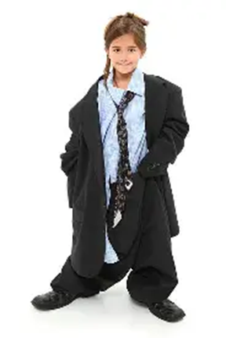

Slide 19
9 And it is my prayer that your love may abound more and more, with knowledge and all discernment, 10 so that you may approve what is excellent, and so be pure and blameless for the day of Christ, 11 filled with the fruit of righteousness that comes through Jesus Christ, to the glory and praise of God

Slide 20
2 Corinthians 11 v 23 – 27
24 Five times I received at the hands of the Jews the forty lashes less one. 25 Three times I was beaten with rods. Once I was stoned. Three times I was shipwrecked; for a night and a day I was adrift at sea; 26 on frequent journeys, in danger from rivers, danger from robbers, danger from my own people, danger from Gentiles, danger in the city, danger in the wilderness, danger at sea, danger from false brothers; 27 in toil and hardship, through many a sleepless night, in hunger and thirst, often without food,[a] in cold and exposure.

Slide 22
Philippians 4 v 21-22
21 Greet every saint in Christ Jesus. The brothers who are with me greet you. 22 All the saints greet you, especially those of Caesar's household.

Slide 23
Genesis 50 v 19 -21
²⁰ As for you, you meant evil against me, but God meant it for good, to bring it about that many people^{[b]} should be kept alive, as they are today. ²¹ So do not fear; I will provide for you and your little ones.” Thus he comforted them and spoke kindly to them.

Slide 24
Relationship
With God the Father
Through Jesus
By the Holy Spirit

Slide 25
God’s Plan
For the glory of Jesus Christ our Lord

